Slide 1
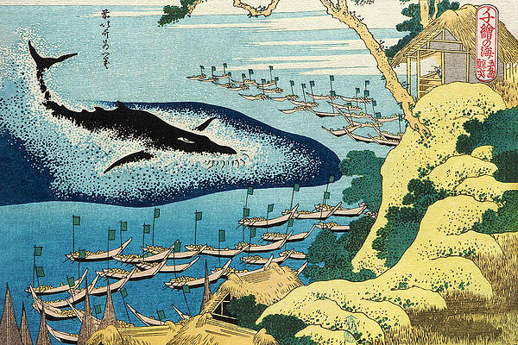
Whale Hunting:
Taking a Stand with Practical Respect

Slide 2
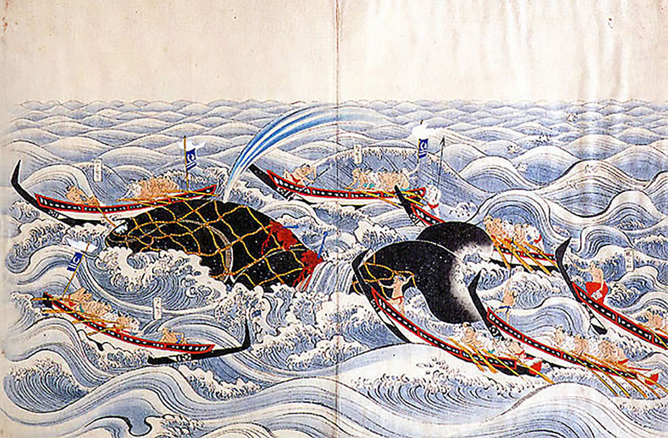
A Delicate Conflict
Whether we should choose to protect the whales for our environment, or respect the traditional culture?

Slide 3
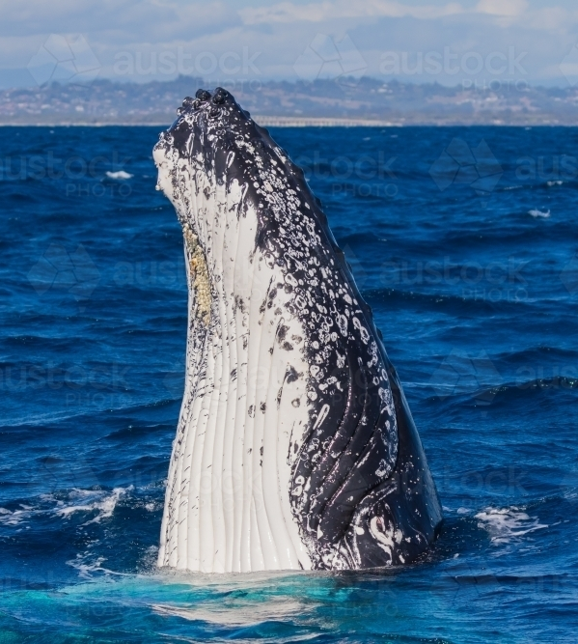
The Priority of Survival
Conservation Must Come First
Culture and heritage are deeply important. But what is a tradition worth if the animal it relies on disappears forever?

Slide 4
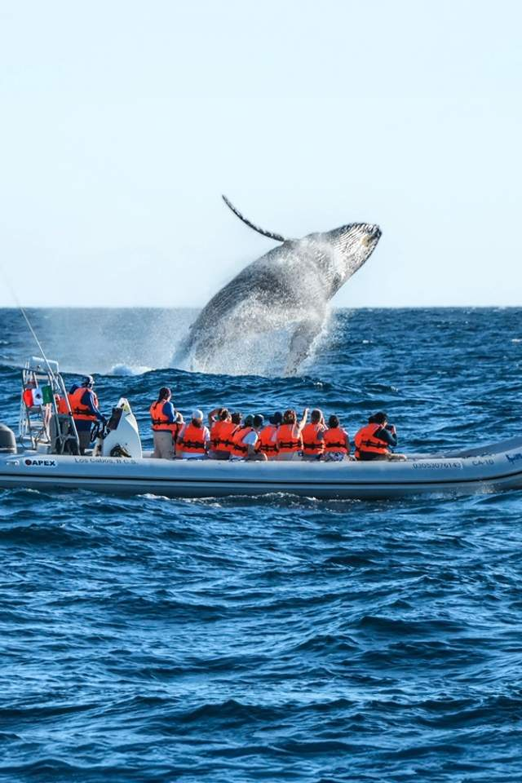
A Living Value Over Whaling
What does a practical solution look like? We can replace the hunting with whale watching.
Global Tourism Economy
$2.1 Billion
tourism, jobs
THE ALTERNATIVE PATH
Local Culture
Songs, rituals, symbolic celebrations

Slide 5

“We do not have to destroy whales to save a culture, nor crush a culture to save whales. We can choose a wiser path — where traditions adapt, animals survive, and humanity learns to honor life in all its forms.”
— A Philosophy of Coexistence

